Slide 1
Python Basics
For Engineers Workshop
By Saifeldin and Fardin
Notes:
Just introduce us;
I’ll include notes on what to say here so you can get an idea.

Slide 2


What is Python?
Python is a ;
High level
Dynamically typed
Strongly typed
Objected Oriented
Functional
Interpreted
General purpose
Programming language.
Notes:
Saif; {Read the bullet points and explain what it means,}
High level = No control over registers or memory or garbage collection.
Dynamically type = No ned to declare types of variables
Strongly typed =Operations with only same data types.
Functional = Has functions
Object oriented = Has classes and methods, everything in python is an object
Interpreted = Code is run by an interpreter, it is not compiled, this has advantages and disadvantages

Slide 3


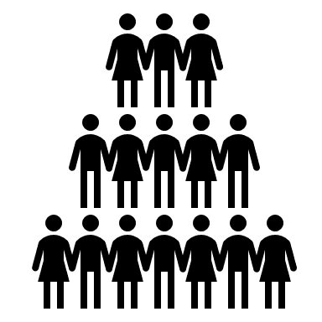
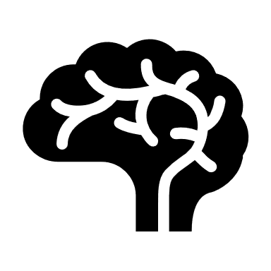
Why use Python?
Python is easy
Python is as close to working pseudocode as it gets with a real programming language.
Jack of all trades
Due to its ease, it is used for web-development, scripting, data-science, scientific computing and many more.
Community
Python is free and open-source (unlike MATLAB). That means a large community and many interesting libraries and plenty of support.
Machine Learning
It is THE language for AI/Machine learning.
Tensorflow,Scikit-Learn, PyTorch, all fundamental.
Notes:
Saif- Just explain the points, you can read almost word for word

Slide 4



Why not use Python?
Slow
If you are programming a rockets embedded systems, its best you stick to C.
Complicated
Given how simple it is, you will need good programming fundamentals to not get ahead of yourself and create the dreaded spaghetti codebase.
Master of none
“Python is the second best programming language for everything.”
Except ML maybe?
Notes:
Saif- Just explain the points, you can read almost word for word

Slide 5
Philosophy of python
Python is a language that is full of inside jokes, easter eggs and has its own philosophy so to speak. Explaining all of this in detail is beyond the scope of this lecture but to truly become the best possible programmer you will have to not only explore the technical side of the language but its philosophy as well.
As a beginner you might scoff at all of this, but later on in your programming journey you will realize that just writing code that works isn’t enough. It has to follow a structure and “grammar” much in the same way speaking any natural language does.
Notes:
Fardin

Slide 6
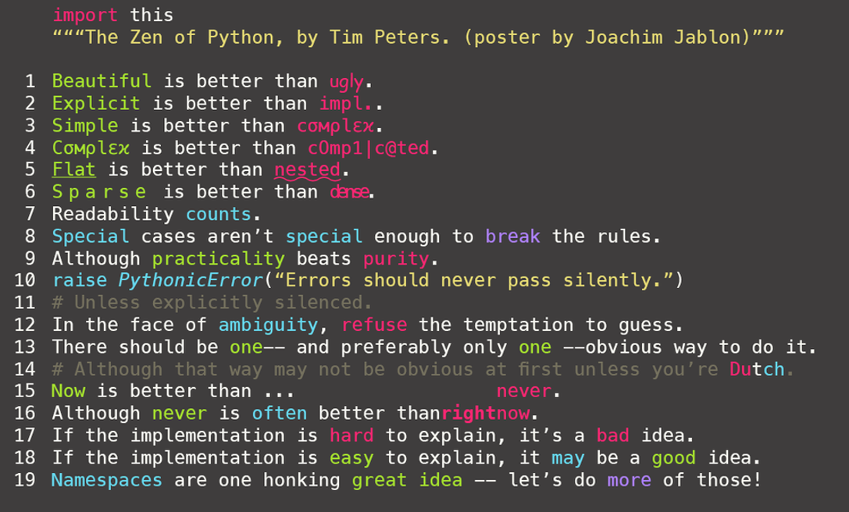
Why not use Python?
Slow
If you are programming a rockets embedded systems, its best you stick to C.
Complicated
Given how simple it is, you will need good programming fundamentals to not get ahead of yourself and create the dreaded spaghetti codebase.
Master of none
“Python is the second best programming language for everything.”
Except ML maybe?
Notes:
Fardin

Slide 7
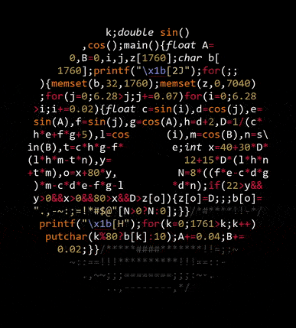
Notes:
Fardin

Slide 8
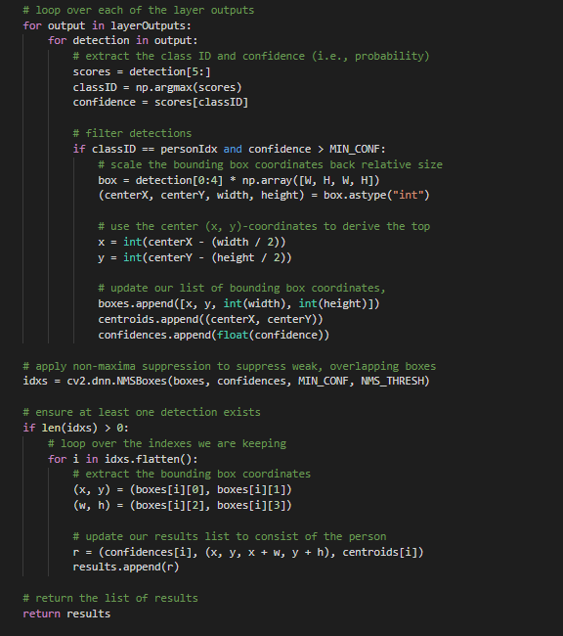
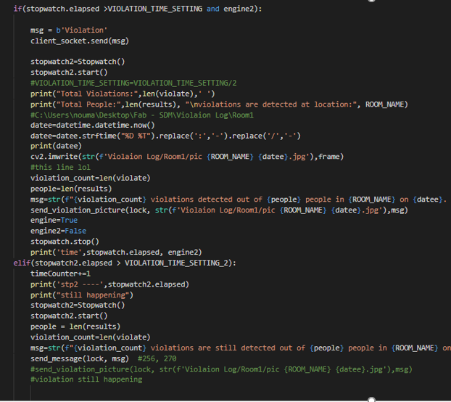
A practical example
Notes:
Fardin

Slide 9
Where to begin?
I am a noob
Python Online IDE: Online Python Interpreter and interactive shell – Replit
I am serious
Python Download: www.python.org
PyCharm by Jet Brains: PyCharm: the Python IDE for Professional Developers by JetBrains
Visual studio code: Visual Studio Code - Code Editing. Redefined
Notepad++ (Windows only): Downloads | Notepad++ (notepad-plus-plus.org)
I am serious (but lazy, or really like data science)
Anaconda : Anaconda
Notes:
Fardin

Slide 10
Extra resources
Python Documentation: The Python Tutorial — Python 3.9.7 documentation
(To be honest this is THE BEST source, it’s hard but nothing else comes close!)
Useful videos: (1) Python Tutorial - Python for Beginners [Full Course] – YouTube
(1) Learn Python - Full Course for Beginners [Tutorial] – YouTube
Books: Think Python: The most basic of this list, Think Python provides a comprehensive Python reference.
Fluent Python: While Python’s simplicity lets you quickly start coding, this book teaches you how to write idiomatic Python code, while going into several deep topics of the language.
Effective Python: 59 Ways to Write Better Python: This relatively short book is a collection of 59 articles that, similarly to Fluent Python, focus on teaching you how to write truly Pythonic code.
Python Cookbook: As a ‘cookbook’, this will be a good reference on how to use Python to complete tasks you have done in another language.
Notes:
Saif

Slide 11
Let’s start Coding ☺
If you don’t have python installed on your pc open up the Replit online IDE if you want to code along.
https://replit.com/
Any questions so far?
Notes:
Saif

